Slide 1




Basketball II
Produced by Dr. Mario
UNC STOR 390

Slide 2
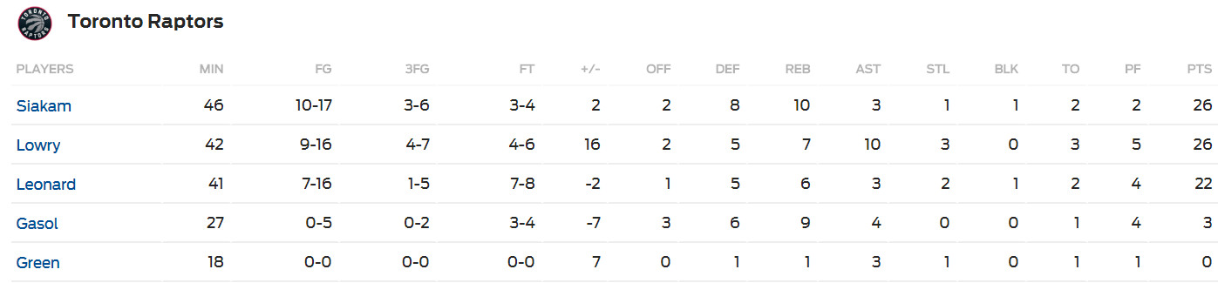
+/- Player Ratings
Recall the Box Score
Traditional Statistics Do Not Measure Player’s Ability to … “Make the Team Better”
Notice the Additional Metric

Slide 3
+/- Player Ratings
Pure +/- Ratings
Historically from Hockey
Number of Goals a Player’s Team Outscores Opponent When a Specific Player is Playing on Ice
Highest: Bobby Orr, 1970-1971, +124
“Worst Statistic in Hockey” by Hockey-Graphs.com
Counting Statistic of Rare Event (Subject to Outliers)
Time on Ice Not Reflected
Players Who Play the Most and Least Have +/- Closer to 0
Weakest Players Not Given Time to Accumulate Negative +/-
Same Values are Not Equal i.e. +5 Can Result from Many Scenarios
Application to Basketball
Pure +/- Statistic Based on Points and Scaled to 48 Minutes
Depends on Quality of Players When Player is on Court
Players on Bad Teams (Below .500 Record) Get Penalized

Slide 4
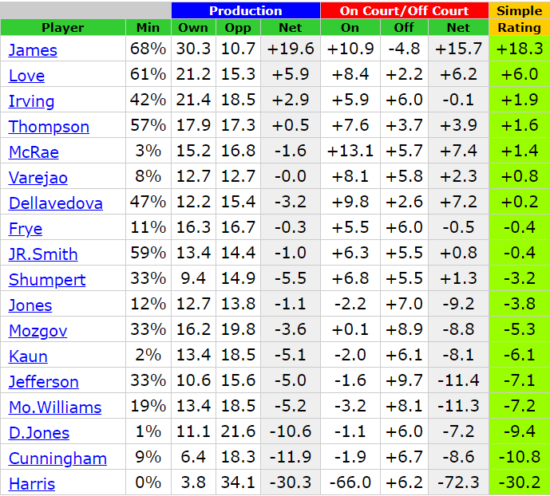
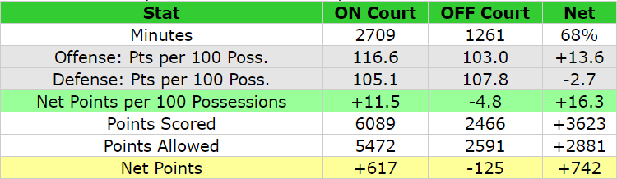


+/- Player Ratings
Pure +/- Ratings
Found on www.82games.com
Cavs Championship Season
Seasonal Player Stats
Lebron James on the Court
Lebron James on Bench
Pure +/- Per 48 Minutes
$$Net Points Per Min×48 Min=\frac{617}{2709}×48$$
$$=0.22776×48=10.9$$
$$Net Points Per Min×48 Min=\frac{−125}{1261}×48$$
$$=−0.09913×48=−4.8$$
$$Court −Bench=10.9−\left(−4.8\right)=15.7$$

Slide 5
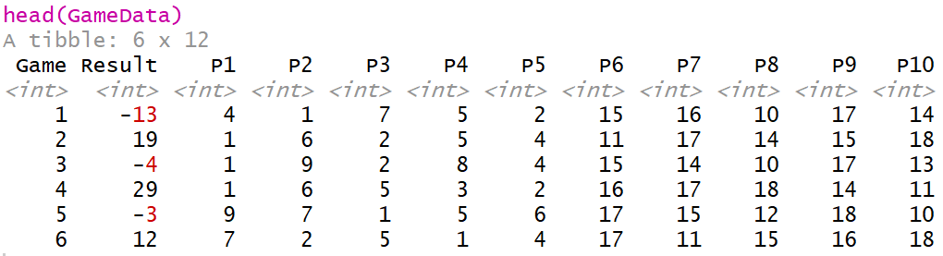
+/- Player Ratings
Adjusted +/- Rating
Adjustment for Teammates Played With
Adjustment for Opponents Played Against
Adjustments Based on Play-by-Play Data Over Whole Season
Average +/- Rating = 0
Simulated Game Data
Players 1-9 Compete Against Players 10-18 in 20 Games
Assume Starters Play the Entire Game
Results of Game Shown Below

Slide 6
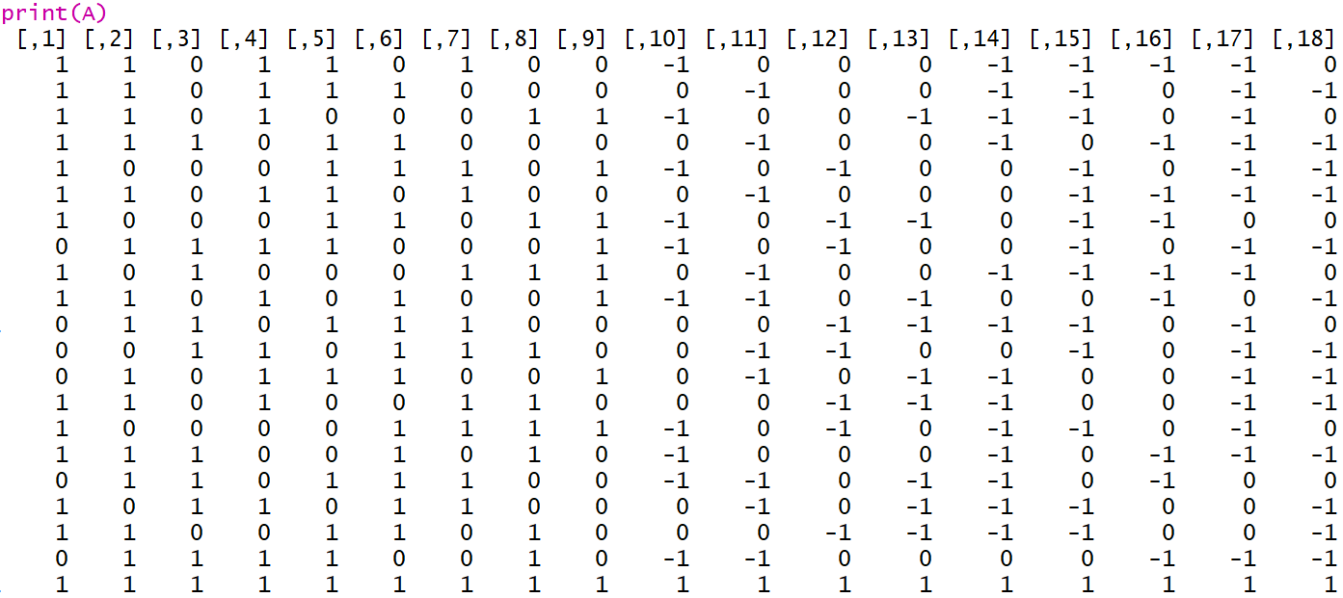
+/- Player Ratings
Modified Game Data into Matrix (A)
Each Row is a Different Game (Except Last Row)
Each Column is A Different Player
1 = Played on Team 1
0 = Did Not Play
-1 = Played on Team 2
Notice Last Row of All 1’s

Slide 7
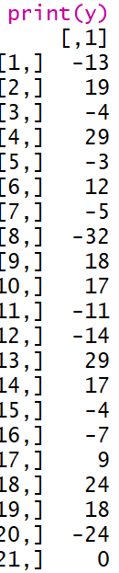
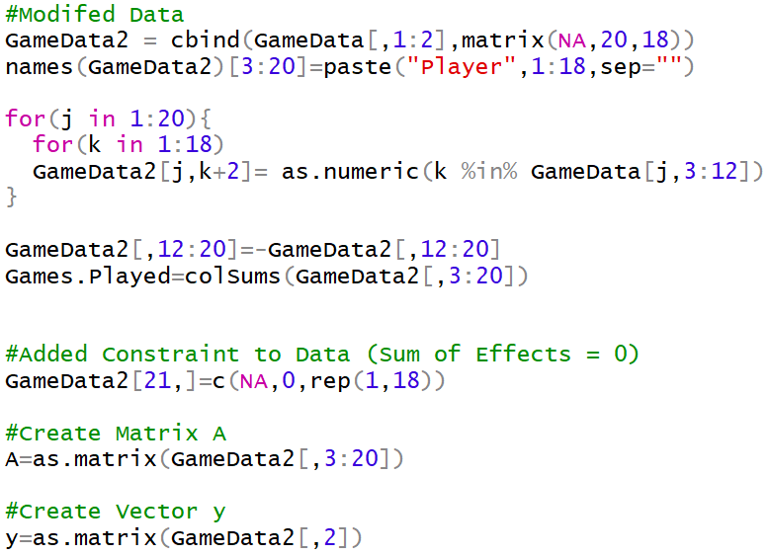
+/- Player Ratings
Game Results into Vector (y)
Each Element is a Different Game (Except Last One)
Notice 0 in Last Element
Code Used to Create Matrix A and Vector y

Slide 8
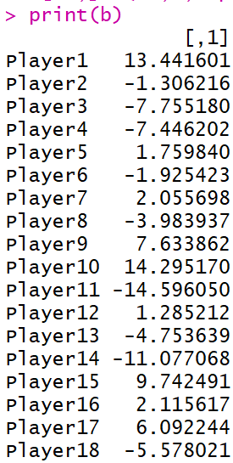




+/- Player Ratings
Goal: Estimate Adjusted +/- for All 18 Players
Expressed into Vector (b)
Constraint: We Want The Sum of Adjusted +/- to Equal 0
We Invoke Constraint With Last Row of A and Element of y
Solve the Linear Equation Using Least Squares Regression
Code for Solving System of Linear Equations
Adjusted +/- For Each Player
$$\overset{⃑}{b}=\left[b_{1},b_{2},⋯,b_{18}\right]′$$
$$\overset{⃑}{y}=A\overset{⃑}{b}+ε$$
$$\overset{⃑}{b}≈{\left(A^{′}A\right)}^{−1}A′\overset{⃑}{y}$$

Slide 9
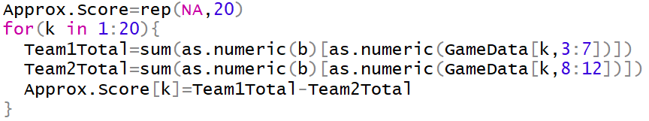

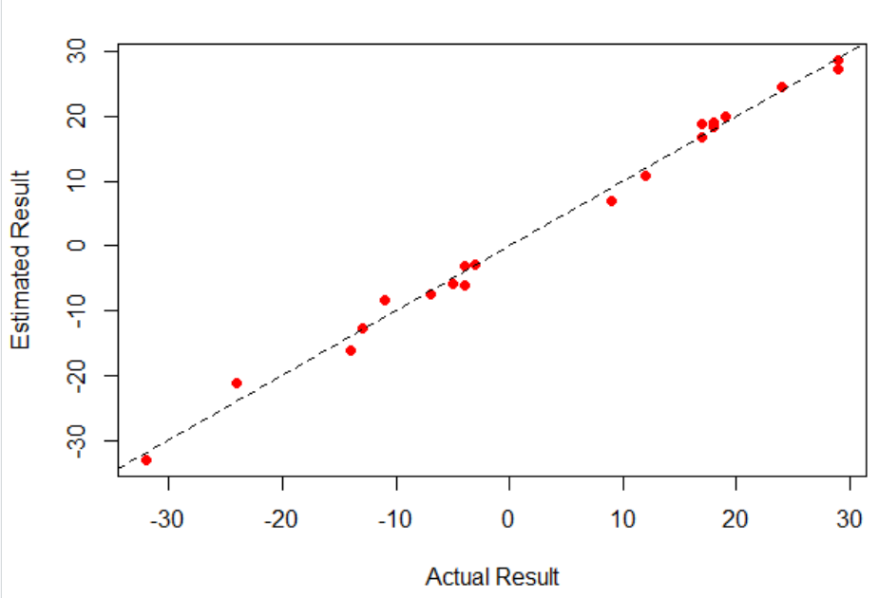
+/- Player Ratings
Can Be Used to Approximate Game Result
Code to Calculate Predicted Scores Using Adjusted +/-
Code and Graphic Comparing Predicted Versus Actual

Slide 10



Basketball Statistics
Classic Measures of Field Goal Percentage
Effective Field Goal Percentage (EFG)
Problem with Previous Metrics
Knicks: 15/20 Field Goals = 30 Points
Lakers: 15/20 3-Pt Field Goals = 45 Points
Same Field Goal Percentage (75%)
New Metric
Adjusted EFG%
Knicks: 75%
Lakers: 1125%
FGM = Field Goal Made
FGA = Field Goal Attempt
3FGM = 3-Pointer Made
3FGA = 3-Pointer Attempt
$$FG\%=\frac{FGM}{FGA}$$
$$3FG\%=\frac{3FGM}{3FGA}$$
$$EFG\%=\frac{FGM+0.5×3FGM}{FGA}$$

Slide 11

Final Inspiration
Nine out of 10 schools are cheating.
The other one is in last place.
- Jerry Tarkanian

